Slide 1
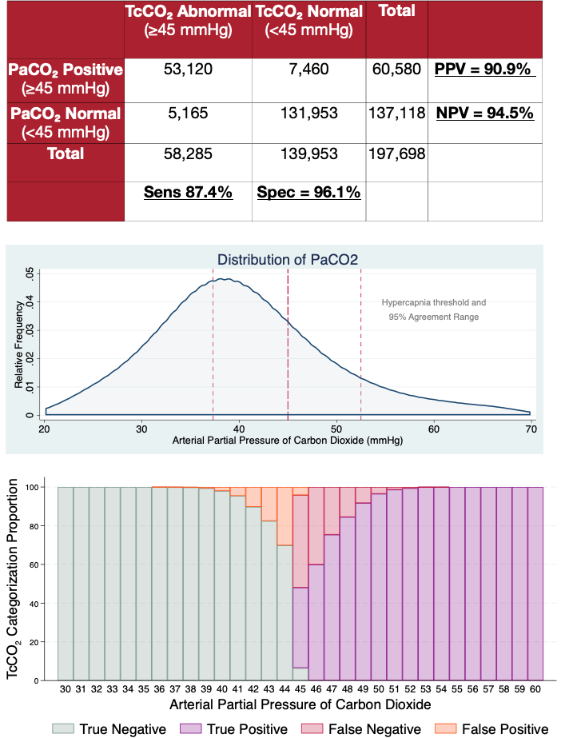
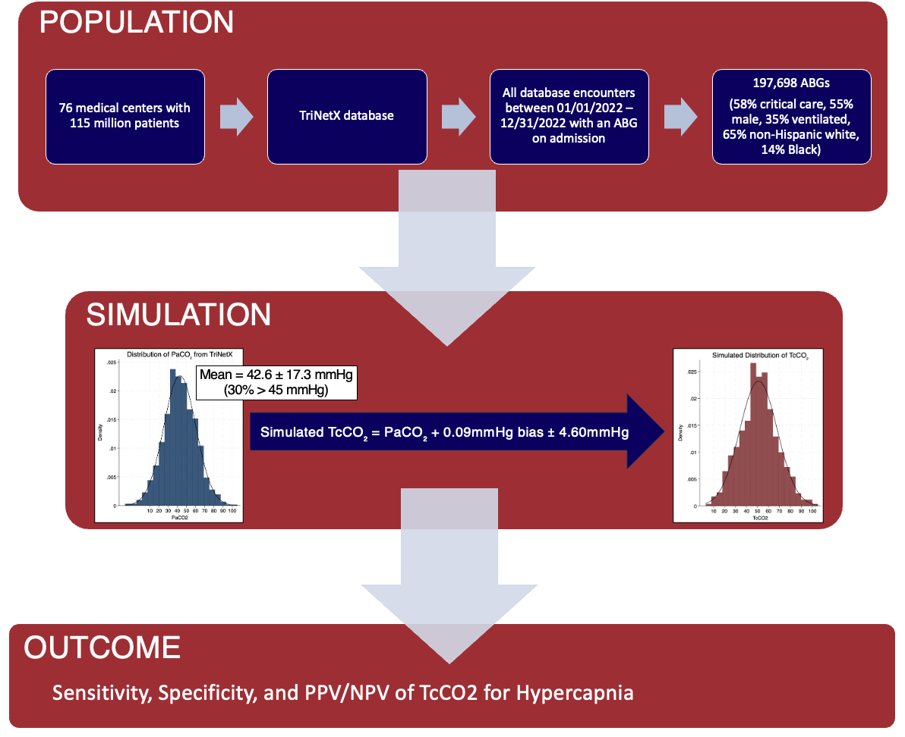


Is an ABG really necessary to detect Hypercapnia?
An In-Silico Simulation of Transcutaneous CO2 to Identify Hypercapnia on Admission
Dustin M Anderson-Bell MD¹, Brian W Locke MD MSc²
1: University of Utah Health, Division of Pulmonary and Critical Care; 2: Intermountain Medical Center, Division of Pulmonary and Critical Care
INTRODUCTION
RESULTS
CONCLUSIONS
Problem: Accurate detection of elevated arterial CO₂ (PaCO₂) is essential for studying hypercapnic respiratory failure.
Gap: The invasive gold-standard ABG may deter participation, and the accuracy of non-invasive transcutaneous CO₂ (TcCO₂) sensors remains uncertain.
Objective: Simulate TcCO₂ accuracy using published error estimates (Conway et al., 2017) to assess its ability to identify hypercapnia in hospitalized adults.
In simulation, TcCO2 would have been highly accurate for identifying hypercapnia in those who received ABGs because most obtained PaCO2 values are outside the TcCO2-PaCO2 use limits of agreement.
Next steps: Similar testing for test characteristics in other populations (ie outpatient setting, critically ill, etc).
LIMITATIONS
Patients receiving ABGs may have more extreme PaCO2 derangements than those without ABGs.
Disagreement between TcCO2 and PaCO2 may be non-Gaussian.
METHODS
ACKNOWLEDGEMENTS
This work is supported by grants from the American Thoracic Society (ASPIRE fellowship), the Intermountain Fund, and the National Institutes of Health (Ruth L. Kirschstein National Research Service Award 5T32HL105321 and National Center for Advancing Translational Sciences Award UM1TR004409 )
Notes:
Preparing your poster for printing:
Go to File > Save As. Under Save as type (Windows) or Format (OS X), select PDF.
Open the PDF in Adobe Photoshop. Go to File > Save As. Under Format, select JPEG or TIFF. Choose a location and file name for your file and click Save. Click OK on the default save settings.
DO NOT SAVE TO A JPEG OR TIFF FROM POWERPOINT!
48 inches wide X 36 inches high

Slide 2
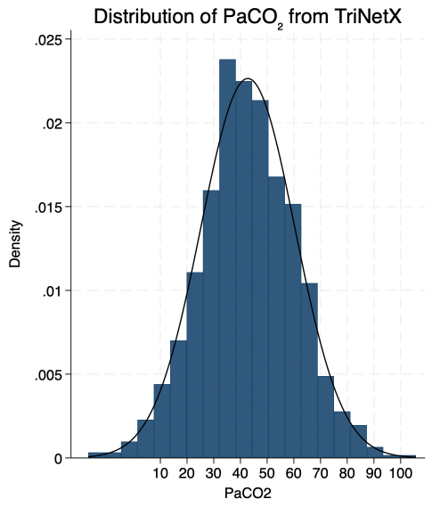
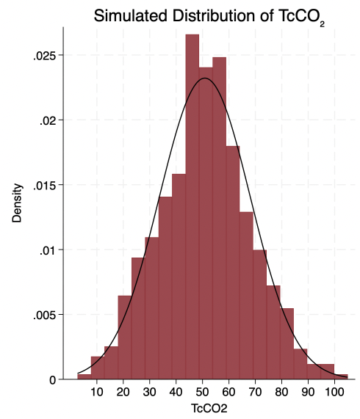
Sensitivity, Specificity, and PPV/NPV of TcCO2 for Hypercapnia
POPULATION
76 medical centers with 115 million patients
TriNetX database
All database encounters between 01/01/2022 – 12/31/2022 with an ABG on admission
197,698 ABGs
(58% critical care, 55% male, 35% ventilated, 65% non-Hispanic white, 14% Black)
-
SIMULATION
Mean = 42.6 ± 17.3 mmHg
(30% > 45 mmHg)
Simulated TcCO₂ = PaCO₂ + 0.09mmHg bias ± 4.60mmHg
OUTCOME

Slide 3
Mean = 42.6 ± 17.3 mmHg
(30% > 45 mmHg)
Simulated TcCO₂ = PaCO₂ + 0.09mmHg bias ± 4.60mmHg
Notes:
Code for graph:
* Create first histogram and save it
clear
set obs 1000
gen PaCO2 = rnormal(42.6, 17.3)
histogram PaCO2, bin(20) normal color(navy) ///
xscale(range(10 100)) xlabel(10(10)100) ///
title("Distribution of PaCO₂ from TriNetX") ///
name(hist1, replace)
* Create second histogram and save it
clear
set obs 1000
gen TcCO2 = rnormal(50, 17.3)
histogram TcCO2, bin(20) normal color(maroon) ///
xscale(range(10 100)) xlabel(10(10)100) ///
title("Simulated Distribution of TcCO₂") ///
name(hist2, replace)
* Combine the two graphs side-by-side
graph combine hist1 hist2, cols(2)

Slide 4
 | TcCO₂ Abnormal (≥45 mmHg) | TcCO₂ Normal (<45 mmHg) | Total
PaCO₂ Positive (≥45 mmHg) | 53,120 | 7,460 | 60,580 | PPV = 90.9%
PaCO₂ Normal (<45 mmHg) | 5,165 | 131,953 | 137,118 | NPV = 94.5%
Total | 58,285 | 139,953 | 197,698
 | Sens 87.4% | Spec = 96.1%

